Slide 1
British Airways Customer Reviews
Ajay Iyer
December 6 2022

Slide 2
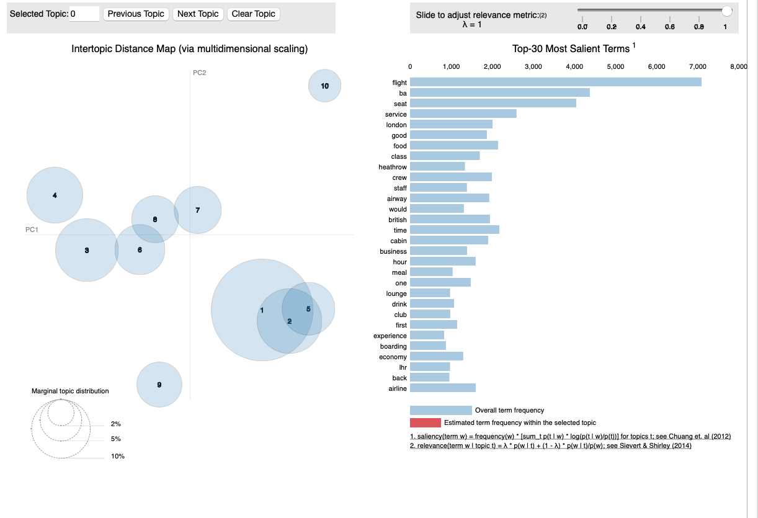
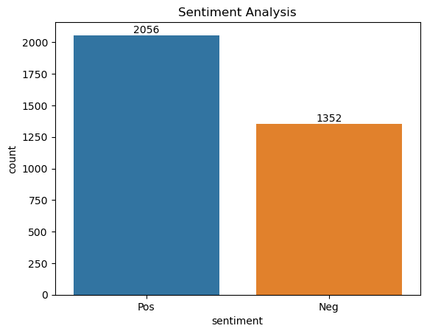
Analysis
Topic Modeling
The frequency chart shows that seat, service, staff were some of the most discussed when reviewing the airline
Sentiment Analysis
Out of 3,408 reviews, 60% were positive while the remaining 40% were negative reviews.

